Slide 1
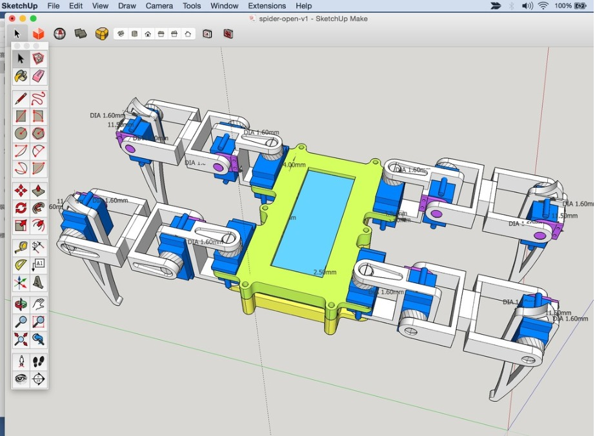
Bio-inspired Walking Robot
EEE437-Bionic
Mid EVALUATION presentation
Group 19
1087-m.s.m.m.d.Senanayake
1140-s.p.a.Jayawardena
1250-d.m.p.r.Hettiarachchi
1247-a.m.senadeera
1224-t.v.t.i.vithanage

Slide 2

INTRODUCTION
A robot is a machine created to carry out one or more activities quickly and accurately.
There are various applications for robots in the world, such as automated manufacturing and risky vocations.
The leg drive, mechanics, hardware architecture, and leg control techniques for walking machines are all part of this research.
We create a spider in the form of a 4-legged robot.

Slide 3
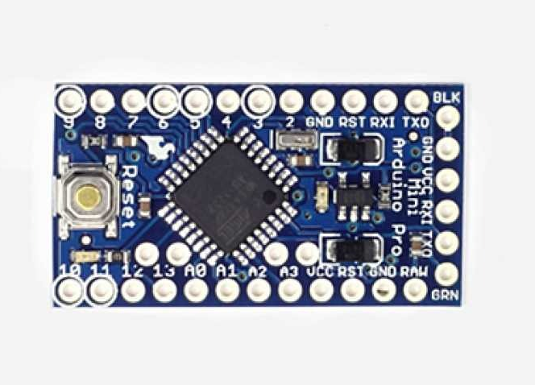
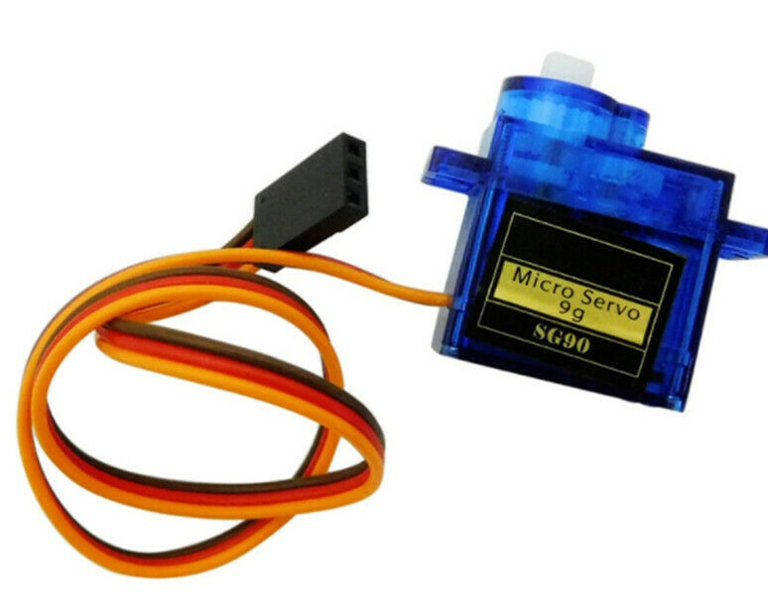
WE USED …..
HARDWARE
Arduino Uno
Servo Motors
Battery
SOFTWARE
Arduino IDE Software

Slide 4
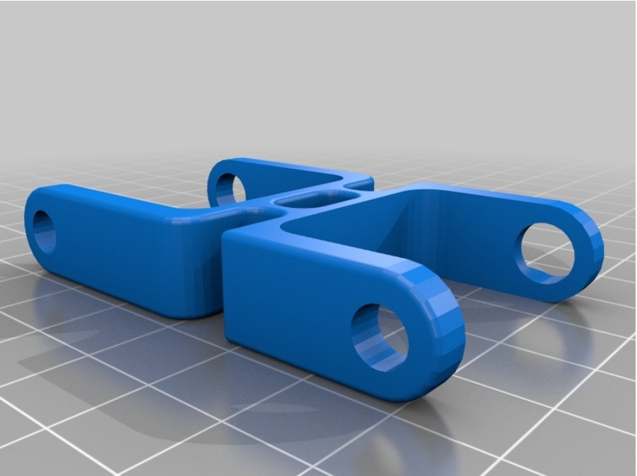
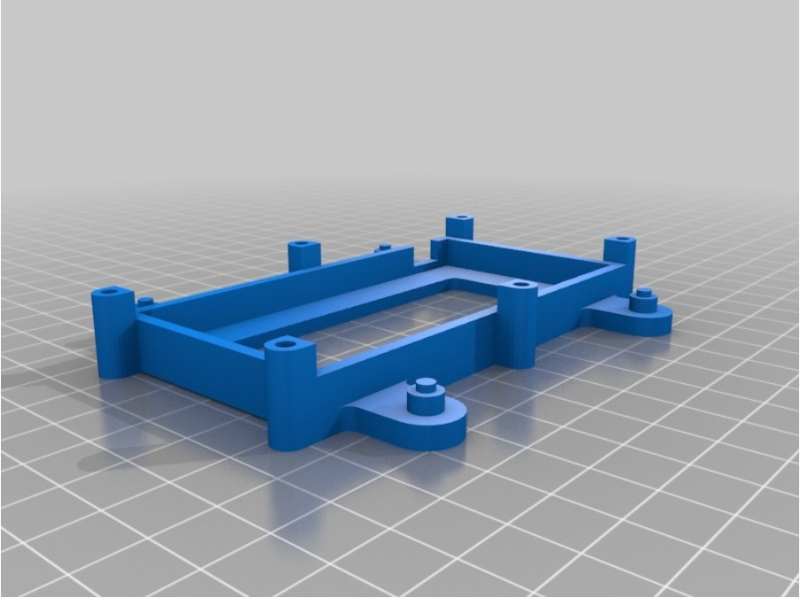
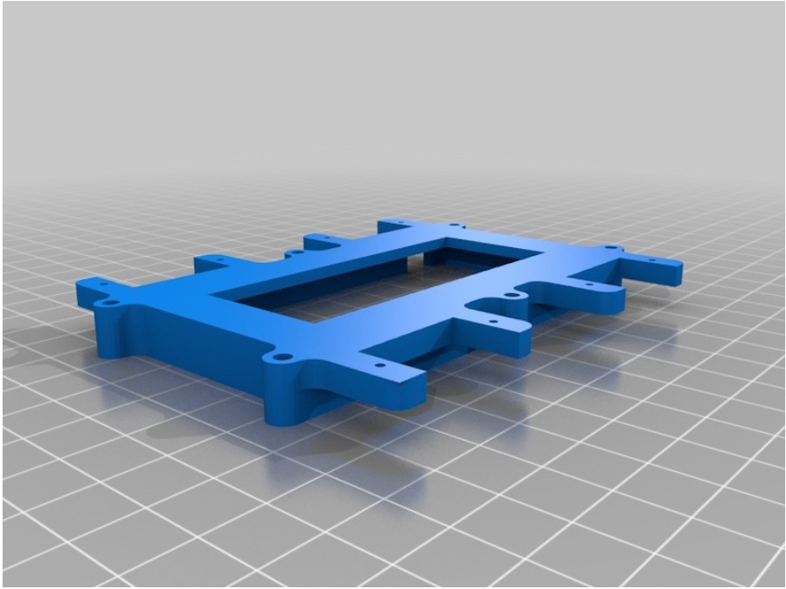
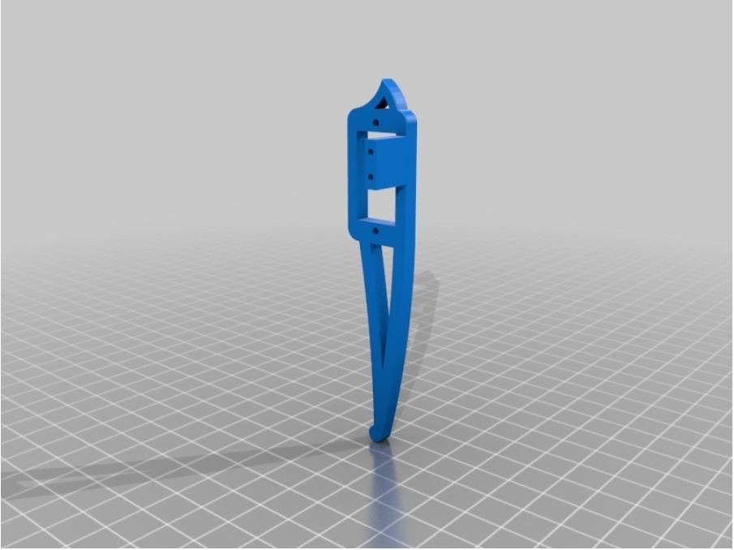
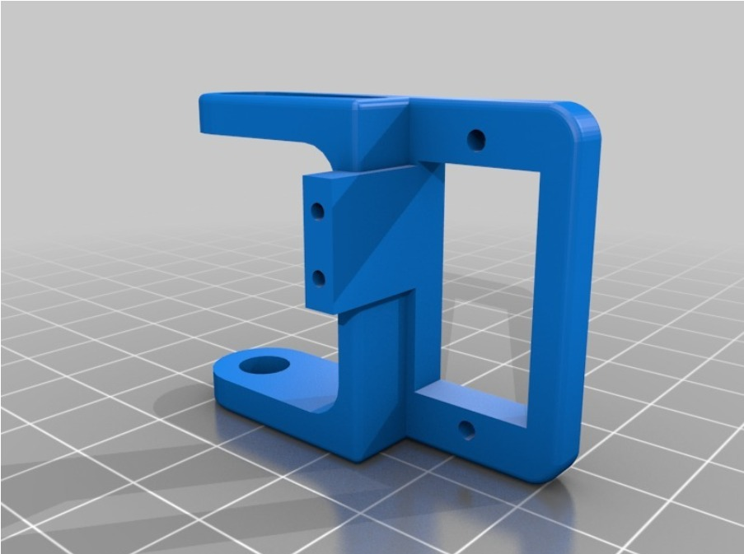
GALLERY

Slide 5
THANK YOU !

